Slide 1
Sensitivity to Unmeasured Confounding
Lucy D’Agostino McGowan

Slide 2

http://bit.ly/bios8375

Slide 3
Meaningful confounders
1. How imbalanced is the unmeasured confounder between the exposure groups?
2. How predictive is the unmeasured confounder of the outcome?
3. How independent is the unmeasured confounder from the other covariates?

Slide 4
Meaningful confounders
1. How imbalanced is the unmeasured confounder between the exposure groups?
2. How predictive is the unmeasured confounder of the outcome?
3. How independent is the unmeasured confounder from the other covariates?

Slide 5

Propensity scores
0.2
0.2
0.3
0.6
0.7
0.8
0.9
0.1
0.1
0.2
0.2
0.3
0.6
0.7
0.8
0.9

Slide 6
Imbalance between exposures
0.2
0.2
0.3
0.6
0.7
0.8
0.9
0.1
0.1
0.2
0.2
0.3
0.6
0.7
0.8
0.9

Slide 7
Propensity Scores
Imbalance between exposures
0.2
0.2
0.3
0.6
0.7
0.8
0.9
0.1
0.1
0.2
0.2
0.3
0.6
0.7
0.8
0.9

Slide 8
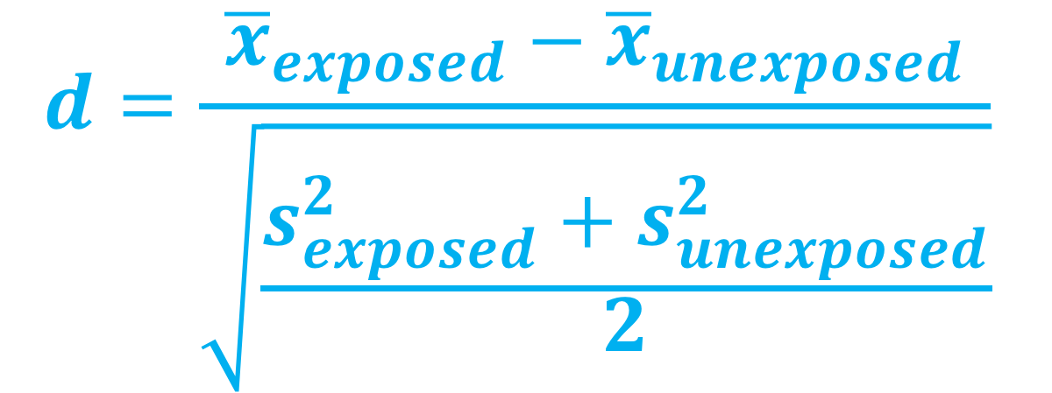
Standardized mean difference
$$d=\frac{{\overline{x}}_{exposed}−{\overline{x}}_{unexposed}}{\sqrt{\frac{s_{exposed}^{2}+s_{unexposed}^{2}}{2}}}$$

Slide 9
Standardized Mean Difference
 | Exposed | Unexposed | SMD
n | 1897.07 | 1900.24
mustache | 60.71 (16.95) | 60.90 (15.61) | 0.012
cowboy hat | 204.59 (101.45) | 202.90 (106.44) | 0.016
glasses | 70.77 (27.00) | 70.51 (27.50) | 0.01
smoker | 37.46 (10.93) | 37.40 (11.28) | 0.005
crazy hair | 2.27 (2.46) | 2.27 (1.82) | 0.003
smile | 2.49 (5.48) | 2.47 (4.80) | 0.003
sick | 30.92 (8.23) | 30.95 (7.54) | 0.003
harry potter | 3.04 (0.69) | 3.03 (0.93) | 0.01
healthy | 145.4 (7.7) | 152.2 (8.0) | 0.013

Slide 10
Imbalance between exposures
Love Plots

Slide 11
Meaningful confounders
1. How imbalanced is the unmeasured confounder between the exposure groups?
2. How predictive is the unmeasured confounder of the outcome?
3. How independent is the unmeasured confounder from the other covariates?

Slide 12
Observed bias plot

Slide 13
unmeasured confounding

Slide 14
Quantify unmeasured confounding
Lin, Psaty, & Kronmal
Rosenbaum & Rubin
Schlesselman
Cornfield

Slide 15
All you need
Exposure-outcome effect
Exposure-unmeasured confounder effect
Outcome-unmeasured confounder effect

Slide 16
All you need
Exposure-outcome effect generally estimated from a model, for example an odds ratio, hazard ratio, or risk ratio
Exposure-unmeasured confounder effect
Outcome-unmeasured confounder effect
Odds Ratio Confidence Interval: (1.5, 2)

Slide 17
All you need
Exposure-outcome effect generally estimated from a model, for example an odds ratio, hazard ratio, or risk ratio
Exposure-unmeasured confounder effect
Outcome-unmeasured confounder effect

Slide 18

Tipping point analyses
what will tip our confidence bound to cross 1

Slide 19
All you need
Exposure-outcome effect generally estimated from a model, for example an odds ratio, hazard ratio, or risk ratio
Exposure-unmeasured confounder effect can use my observed variables to estimate this
Outcome-unmeasured confounder effect

Slide 20
All you need
Exposure-outcome effect generally estimated from a model, for example an odds ratio, hazard ratio, or risk ratio
Exposure-unmeasured confounder effect can use my observed variables to estimate this
Outcome-unmeasured confounder effect

Slide 21

Tipping point analysis
$$Γ\left(LB_{obs}, p_{0}, p_{1}\right)=\frac{\left(1−p_{1}\right)+LB_{obs}(p_{0}−1) }{LB_{obs}p_{0}−p_{1}}$$

Slide 22
1.5
Observed bias plot

Slide 23

Tipping point analysis
$$Γ\left(LB_{obs}, p_{0}, p_{1}\right)=\frac{\left(1−p_{1}\right)+1.5(p_{0}−1) }{1.5p_{0}−p_{1}}$$

Slide 24
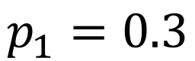
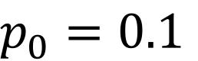
$p_{0}=0.1$
$$p_{1}=0.3$$
Love Plots

Slide 25

Tipping point analysis
$$Γ\left(LB_{obs}, p_{0}, p_{1}\right)=\frac{\left(1−0.3\right)+1.5(0.1−1) }{1.5(0.1)−0.3}$$

Slide 26

Tipping point analysis
$$4.33=\frac{\left(1−0.3\right)+1.5(0.1−1) }{1.5(0.1)−0.3}$$

Slide 27
Standardized Mean Difference
library(tipr)
tip_with_binary(
p0 = 0.1,
p1 = 0.3,
lb = 1.5,
ub = 2)

Slide 28
Standardized Mean Difference
library(tipr)
tip_with_binary(
p0 = 0.1,
p1 = 0.3,
lb = 1.5,
ub = 2)
#> [1] 4.333333

Slide 29
“
A hypothetical unobserved binary confounder that is prevalent in 30% of the exposed population and 10% of the unexposed population would need to have an association with Y of 4.33 to tip this analysis at the 5% level, rendering it inconclusive.
”

Slide 30

Tipping point analysis
$$p_{0}\left(LB_{obs},Γ, p_{1}\right)=\frac{p_{1}\left(Γ−1\right)+1−LB_{obs}}{{LB}_{obs}(Γ−1)}$$

Slide 31

Tipping point analysis
$$p_{0}\left(LB_{obs},Γ, p_{1}\right)=\frac{p_{1}\left(3.5−1\right)+1−1.5}{1.5(3.5−1)}$$

Slide 32

Tipping point analysis
$$p_{0}\left(LB_{obs},Γ, p_{1}\right)=\frac{0.2\left(3.5−1\right)+1−1.5}{1.5(3.5−1)}$$

Slide 33

Tipping point analysis
$$0=\frac{0.2\left(3.5−1\right)+1−1.5}{1.5(3.5−1)}$$

Slide 34
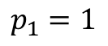
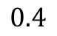
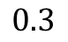
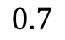
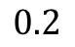
$$0.2$$
prevalence in exposed: 20%
prevalence in unexposed: 0%
outcome association: 3.5
$$0.3$$
$$0.4$$
$$0.7$$
$$p_{1}=1$$

Slide 35

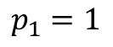
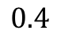
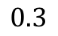
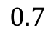
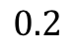
$$0.2$$
$$∞$$
$$0.3$$
$$0.4$$
$$0.7$$
$$p_{1}=1$$

Slide 36
Tipping point analysis
$$p_{0}\left(LB_{obs},Γ, p_{1}\right)=\frac{p_{1}\left(3.5−1\right)+1−1.5}{1.5(3.5−1)}$$

Slide 37

Tipping point analysis
$$0.53=\frac{\left(3.5−1\right)+1−1.5}{1.5(3.5−1)}$$

Slide 38
$$0.2$$
prevalence in exposed: 100%
prevalence in unexposed: 53%
outcome association: 3.5
$$0.3$$
$$0.4$$
$$0.7$$
$$p_{1}=1$$

Slide 39
$$0.2$$
prevalence in exposed: 100%
prevalence in unexposed: 42%
outcome association: 2.37
$$0.3$$
$$0.4$$
$$0.7$$
$$p_{1}=1$$
E-value

Slide 40
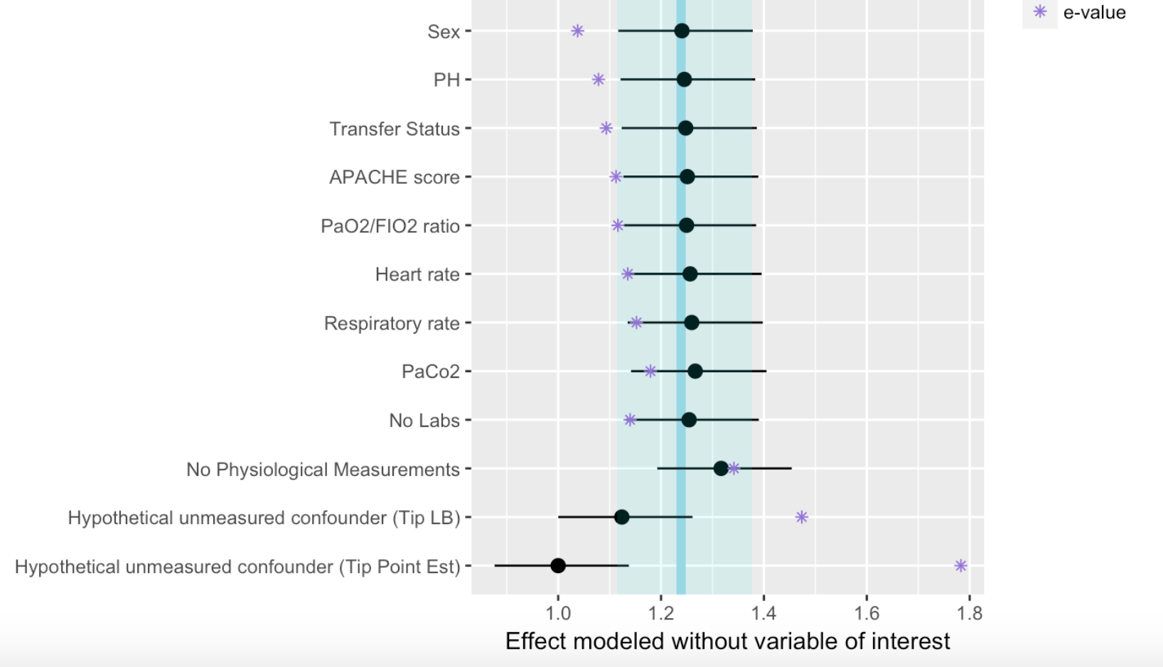

Slide 41
ggdag
https://github.com/malcolmbarrett/ggdag

Slide 42
References
Cornfield, J., Haenszel, W., Hammond, E. C., Lilienfeld, A. M., Shimkin, M. B., & Wynder, E. L. (2009). Smoking and lung cancer: recent evidence and a discussion of some questions. 1959. International journal of epidemiology (Vol. 38, pp. 1175–1191). Oxford University Press. http://doi.org/10.1093/ije/dyp289
Schlesselman, J. J. (1978). Assessing effects of confounding variables. American Journal of Epidemiology, 108(1), 3–8.
Rosenbaum, P. R., & Rubin, D. B. (1983). The Central Role of the Propensity Score in Observational Studies for Causal Effects. Biometrika, 70(1), 41. http://doi.org/10.2307/2335942
Lin, D. Y., Psaty, B. M., & Kronmal, R. A. (1998). Assessing the sensitivity of regression results to unmeasured confounders in observational studies. Biometrics, 54(3), 948–963.
https://cran.r-project.org/web/packages/tableone/vignettes/smd.html

Slide 43


Thank you!
@LucyStats
http://bit.ly/bios8375
lucymcgowan.com

